Slide 1
Monthly Memos and Advocacy
Presented by:
Kimberly Rose
National Board Certified Teacher-Librarian
Brouillet Elementary
roseka@puyallup.k12.wa.us
All handouts may be obtained at:
http://rosekimberly.webs.com/
classes/classhome.html

Slide 2
Overview
Why do monthly memos?
What do you mean, I can use an Infographic?
Are there any other “easy” ways to advocate for my program?
What is a Library (LIT) Advisory Board?
What other bright ideas might the group have?

Slide 3
Monthly Memos
Do I really have time for this?

Slide 4
I don’t have the time to do this!
Do you really have the time not to?
Advocating for libraries can lead to:
Increased District awareness of what is happening in libraries
Increased funding by PTA groups and/or the District
Showing how libraries are so important to basic education!

Slide 5
Why do a monthly memo?
Lets staff (and parents) know what you’re teaching and doing in the library
Shows how the Library program ties to standards and evaluation programs
“Tooting your own horn”!
Can show the importance of the library within the school program

Slide 6
10 Week Memo
Date:
To: [Principal]
From: [Teacher-librarian]
cc: [Advisory Committee, building decision-making team? Assistant principal?]
Re: The Library & Information Program: Making a Difference in Student Learning
© 2006 M. Eisenberg

Slide 7
10 Week Memo
Part 1: (1-2 paragraphs) The purpose of the memo…
Part 2: (3-4 paragraphs) Describe major accomplishments of the library & information program for the 10 weeks. Refer to documentation - matrices).
Part 3: (1-3 paragraphs) Describe goals and plans for the next 10 weeks.
© 2006 M. Eisenberg

Slide 8
My Examples

Slide 9
Evolution… September 2008

Slide 10
Evolution… Annual Report 2008-2009

Slide 11
Evolution… October 2011

Slide 12
Evolution… October 2012

Slide 13
Evolution… October 2012

Slide 14
Evolution… January 2013

Slide 15
Evolution… September 2013

Slide 16
Evolution… September 2013

Slide 17
Evolution… September 2014

Slide 18
Evolution… October 2014

Slide 19
Evolution… October 2014

Slide 20
Evolution… January 2015

Slide 21
Evolution… January 2015

Slide 22
Evolution… September 2015

Slide 23
Evolution… January/February 2017

Slide 24
What do I put for the administrative end of things…?

Slide 25
Suggestions/Ideas:
Updating the Library collection
Money received from PTA
How many new books were added during the month
Labeling – series/locations
Conferences
Presenting
Attending
Classes you’ve taken
AR trophies
Tracking extra students and staff
Circulation
Number of circulations per week
One month’s circulation
Compare circulations between years

Slide 26
Suggestions/Ideas (ctd.):
Working with others (or by yourself) on an endowment
Coordinating guest presenters
Number of new books ordered
Coordinating a visit from the Public library
Summer Reading Program
Working with Inventory team
Working with students to get all books turned in at the end of the year
Teaming conversations with people beyond the walls of your school (sales people, public librarians, parent groups, …)
Number of students per week/month seen in the library
Classes and otherwise

Slide 27
Suggestions/Ideas (ctd.):
Pulling books to link to curriculum
Finding articles for teachers (informational text)
Family Reading Nights / reading events
Reading promotional activities
Technology Support
How much time does it take to troubleshoot technology problems?
Processing materials
How much time does it take to process a book?
How do you process a book? What is involved?
Repairing materials
Training / supervising student helpers
Common Core State Standards – connected with the ADMINISTRATIVE part of our job?

Slide 28
Suggestions/Ideas (ctd.):
A Day in the Life of a Library / Librarian
Snapshot of parent contacts
What are library volunteers doing
Talking to staff about student concerns/management
What is the paraeducator doing?
Because she is doing ______, I can __________.
Other ideas???

Slide 29
Who do I send it to?

Slide 30
Send your memo to…
Your staff
Your administrator(s)
Your regional administrator
Your local Union President (gives them information to help with potential bargaining)
Parents
Post it on your website
Send a link to classroom teachers
Send a link for the School newsletter
The people who make the MONEY decisions! (Can lead to interesting conversations…)
Your School Board
Your Superintendent
Anyone else you think might be interested/need to know!

Slide 31
How do I get started?

Slide 32
START SMALL!!!!!
Maybe a 1 page with a few pictures
Highlights of the month
Highlight a special event/activity
Borrow something I’ve done and tweak it…

Slide 33
“Success is not final, failure is not fatal: it is the courage to continue that counts.”
- Winston Churchill

Slide 34
Piktochart and infographics

Slide 35
Piktochart
Go to http://magic.piktochart.com and log in
Choose a template
Edit anything and everything in the template
Note: If you can’t seem to move/edit something, check to see if it is LOCKED! (shown by RED dots around the item)
Save/share/download as you wish!

Slide 36
Locked vs. Unlocked Elements

Slide 37
Piktochart Pricing

Slide 38
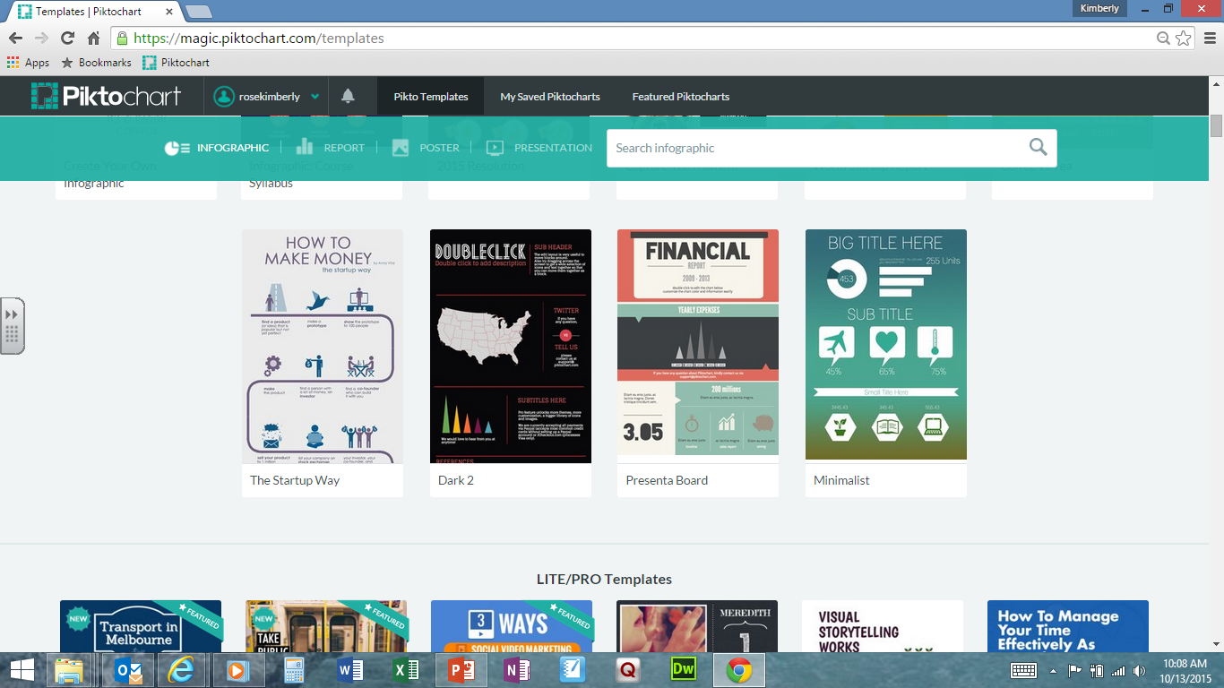
Piktochart Templates

Slide 39
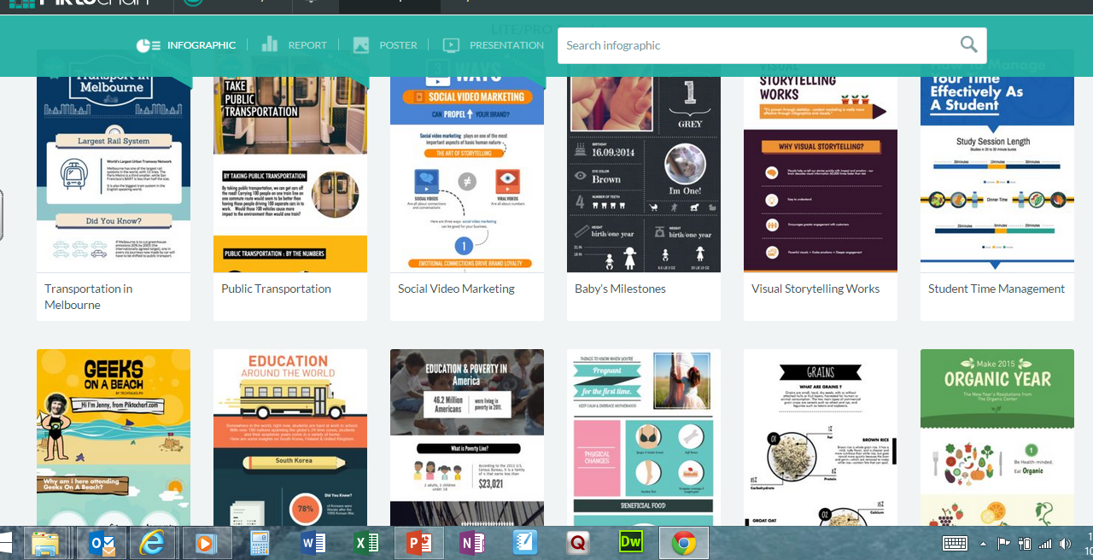
Piktochart PRO

Slide 40
Advisory Committee
Not as scary as it sounds…

Slide 41
LIT Program Advisory Committee
Advise on the broad program
Set priorities for the library & information program focus and emphasis
Help the professional and staff determine where to spend time and effort
Troubleshoot immediate problems
Engage in long-term problem solving and planning for major problems and concerns
Establish policies
© 2006 M. Eisenberg

Slide 42
LIT Program Advisory Committee
Key Questions:
Who are the movers and shakers in the school? Who is respected?
Who gets things done?
Can I get representation from a variety of grade levels and view points?
Library & Info Program Actions
Involve them in decision-making about the library & info program.
Help them to succeed in achieving their goals and priorities.
Link to winners.
© 2006 M. Eisenberg

Slide 43
LIT Program Advisory Committee
Bring up issues for input
What is the issue?
How does it affect the school/students?
Frame the question in a way that you can get a solution to your problem/issue…
Provide possible solutions
Make sure you are okay with all solutions you propose
Frame the solutions in a positive way for your program

Slide 44
LIT Program Advisory Committee
Possible issues
Dr. Almond’s Reading Challenge
Do we want to do it?
How do we set the goals?
Individual student goals
Class goal
We set the goal vs. teachers set the goals
Reorganizing the library
Condensing sections – where is the best locations?
Enhancing the curriculum

Slide 45
You can please some of the people some of the time…
But you can’t please all of the people all of the time.

Slide 46
Thanks for coming!
Kimberly Rose
Email: roseka@puyallup.k12.wa.us
Phone: (253) 841-8670
All handouts may be obtained at:
http://rosekimberly.webs.com/classes/classhome.html

